Slide 1


Python Course
An introduction to programming in Python
Wouter Swart, Bjorn van der Laan
Singapore • 8 January 2019

Slide 2
Agenda
Morning
Introduction into programming
Hands-on
Lunch
Afternoon
Innovation at ING
Introduction to Jupyter Notebooks/exercises
Hands-on
Closing remarks
Notes:
Coffee machine example.

Slide 3



Intro
@ ING since
August 2019
BSc Electrical Engineering, Illinois
Wouter Swart
Bjorn van der Laan
Analytics trainee
IT trainee
Wei Keong Eiew
IT engineer
@ ING since
April 2019
MSc Applied Mathematics,
Delft
@ ING since
April 2019
MSc Computer Science,
Delft
Notes:
Coffee machine example.

Slide 4

Programming: writing down flowcharts
Stacking abstraction layers
Programming means writing orders to be executed by a machine. These orders need to be precise. Programming is similar to human communication:
Language: programming language (Python, Java, …)
Grammar: syntax
Often a choice has to be made as to which action to perform next. The conditions for such a choice need to be made explicit, just like in a flowchart.
Combinations of orders may be applicable multiple times. These can be abbreviated, which results in a higher abstraction level. An example is the functionality of a coffee machine (boil water, grind beans, …).
Notes:
Coffee machine example.

Slide 5
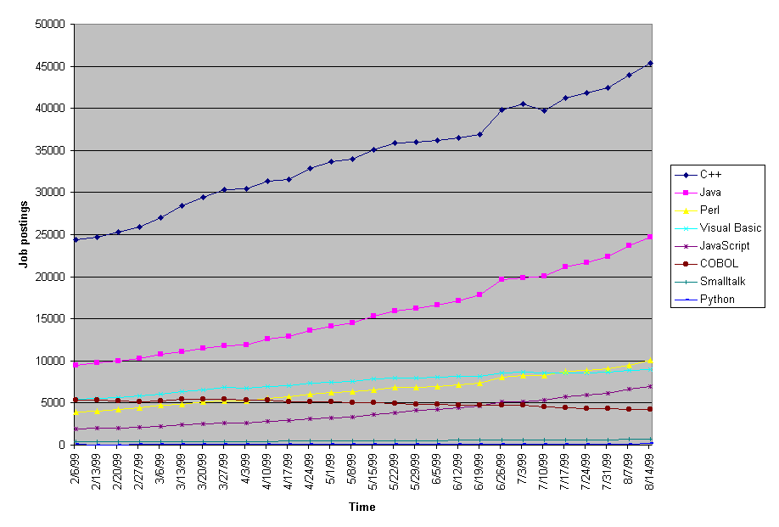
Why Python: nobody was using it before

Slide 6
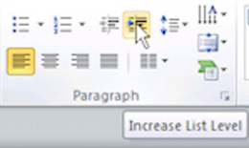
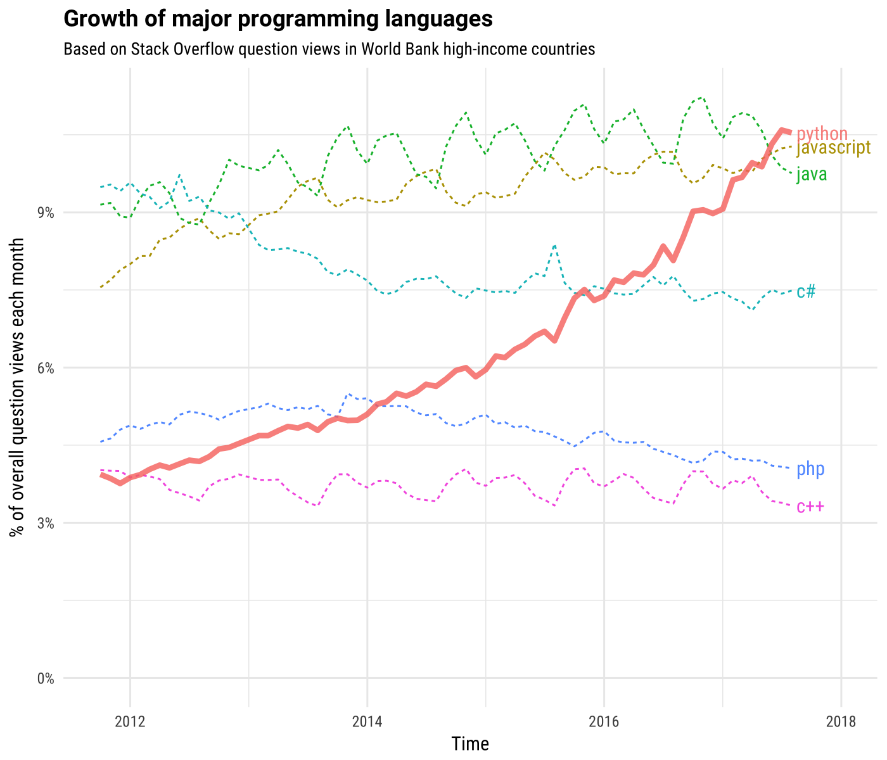
Why Python: now people are!
Using bullets with indent button
Use the indent button to create the text levels with the appropriate bullet.

Slide 7
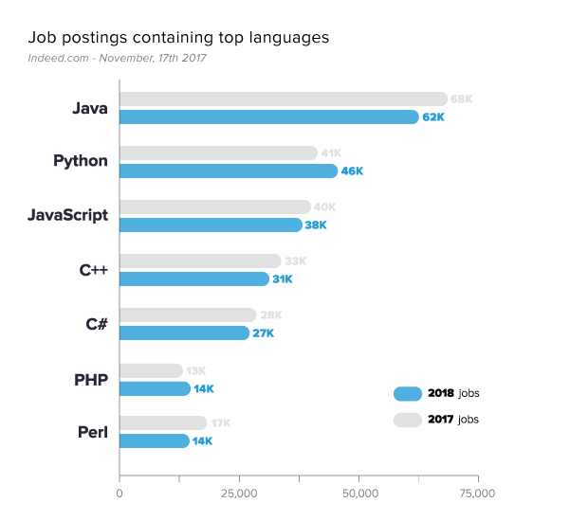
Why Python: many job opportunities

Slide 8
Python use-cases in ING
Fraud detection models
Chat-bot
Quick-pay
Price-elasticity models

Slide 9
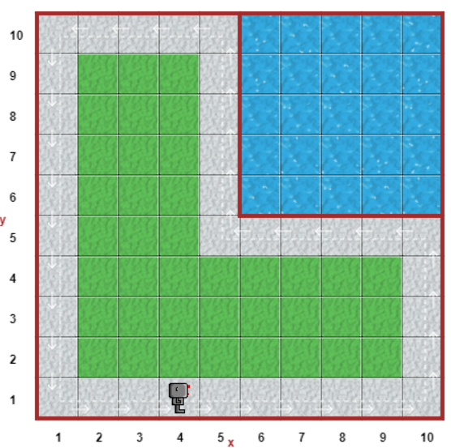
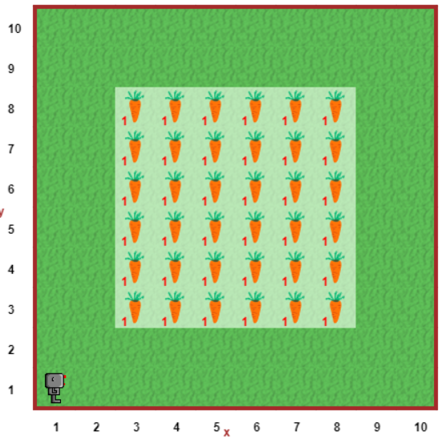
Puzzle – teaser
Around 2
Harvest 1
After
the lecture:
GO!

Slide 10
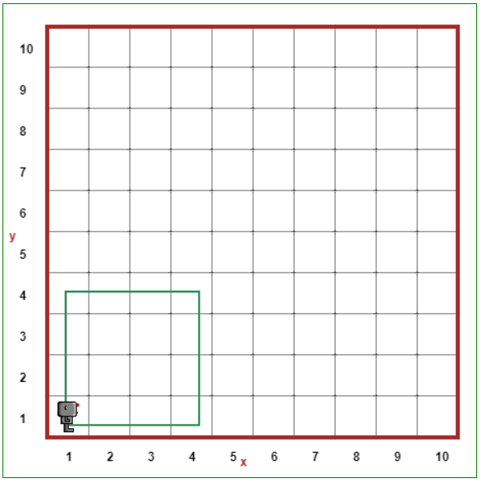
Concepts in Programming
Using bullets with indent button
Use the indent button to create the text levels with the appropriate bullet.
Notes:
On whiteboard:
Run a program
Comments
Functions
Indentation
Loops (for)
Code backup:
# Move a given number of grids
def move_steps_and_turn(steps):
for i in range(0, steps):
move()
turn_left()
# Set speed
think(100)
# Walk in square
for i in range(0, 4):
move_steps_and_turn(5)

Slide 11

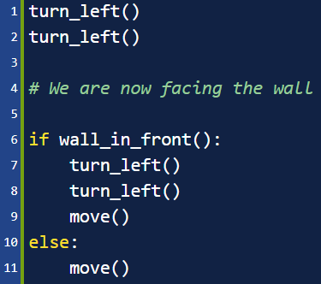
Concepts in Programming (cont.d)
Using bullets with indent button
Use the indent button to create the text levels with the appropriate bullet.
If / else: conditionals in Python
Like in a flowchart, often we need to make a decision based on some condition.
if [condition]:
turn_left()
elif [another condition]:
turn_right()
else:
move()
The [condition] can contain operands like not, and, or, … such as: if wall_in_front() and not object_here():
turn_left()
object_here is a function, that’s why there is () after it

Slide 12
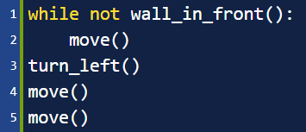
Concepts in Programming (cont.d)
Using bullets with indent button
Use the indent button to create the text levels with the appropriate bullet.
While: conditional loop in Python
Certain decisions need to be repeated as long as some condition holds.
while [condition]:
move()
The indented code is executed over and over again, until the condition no longer holds.
You need to be careful that the condition eventually no longer holds – otherwise it might run ‘forever’ and your application will crash.
The repetition can also be stopped manually, using break. You can create an infinite loop with the condition True, then using break after some if/else-condition within the looped code.

Slide 13
How to define a function
Puzzle – assignment
Around 2
Actions you can take
move() - take a single step
turn_left() - take a left turn
put() - place a ball
take() - pick up object underneath
Conditions you can check
wall_in_front() - whether there is a wall facing you
wall_on_right() - whether there is a wall on your right
object_here() - whether there is an object underneath
Note that you may have to implement functions such as turn_right() yourself. Also you may need if/else, while, not, and, or, break, …
def some_function():
some_action() more_action()
Harvest 1

Slide 14
Puzzle – assignment
Start the assignment now:
https://bit.ly/2jYaYdl
http://reeborg.ca/reeborg.html?lang=en&mode=python&menu=worlds%2Fmenus%2Freeborg_intro_en.json&name=Around%202&url=worlds%2Ftutorial_en%2Faround2.json
Around 2
Harvest 1
GO!

Slide 15
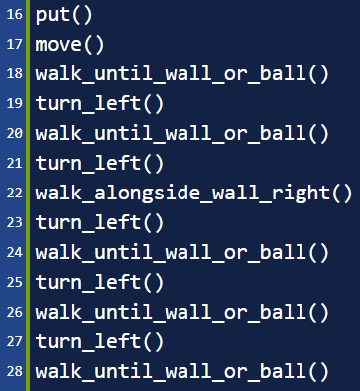
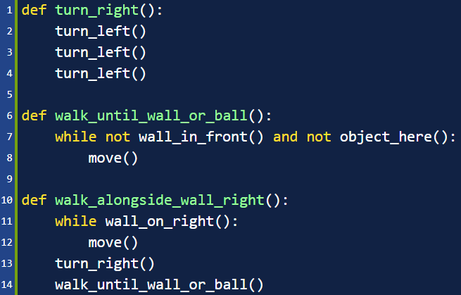
Puzzle – possible solution
Around 2

Slide 16
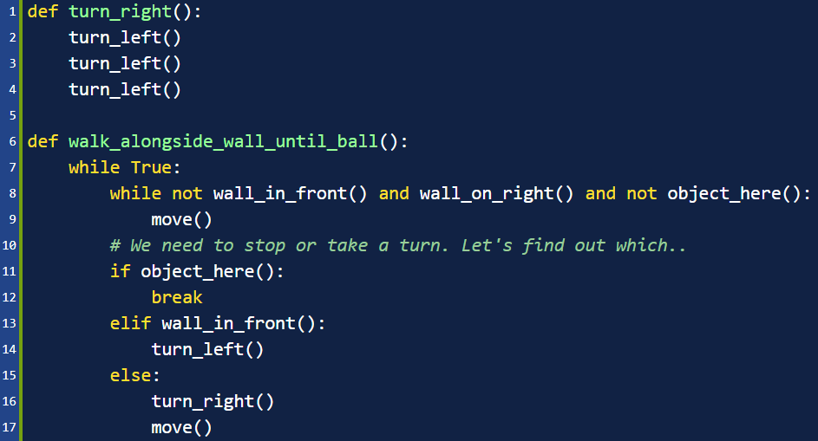
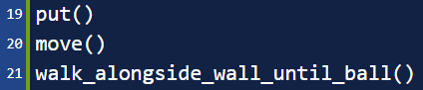
Puzzle – possible solution (2)
Around 2

Slide 17
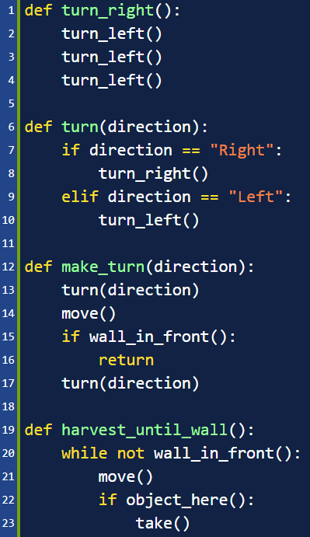
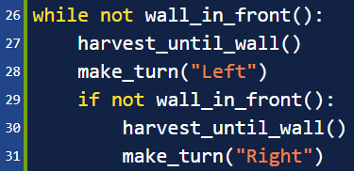
Puzzle – possible solution
Harvest 1

Slide 18
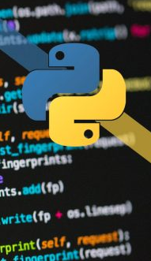
That concludes the morning!
After lunch we will continue with:
Data analytics
Data visualisation
Machine learning
For more courses on basic Python programming go to:
https://www.coursera.org/
https://www.codecademy.com/learn/learn-python-3
https://www.pluralsight.com/paths/python
And feel free to try the robot's other levels anytime!
https://bit.ly/2jYaYdl
Notes:
TODO: which courses are free available for ING Asia employees?

Slide 19

Lunch time!

